Slide 1
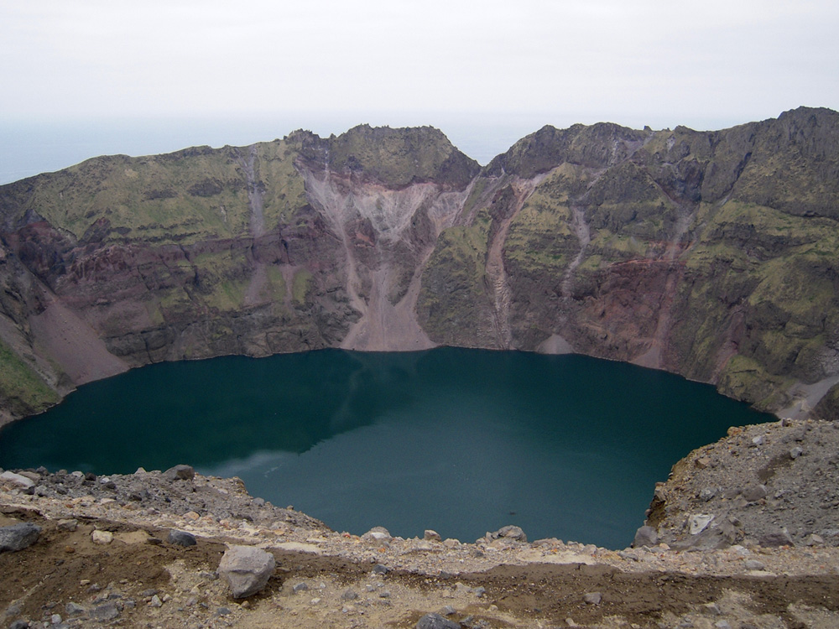
Origins of Post-Eruption Insect Populations on the Volcanic Aleutian Island of Kasatochi
Sayde Ridling University of Alaska Museum / Alaska EPSCoR

Slide 2
Project Goals
Kasatochi Island
Methods
Results
Future work

Slide 3
The goal of this project is to try to determine the origins of post eruption Kasatochi Island insect populations by analyzing their relationship to pre-eruption, post-eruption, and nearby island insect populations.

Slide 4
Project Goals
Kasatochi Island
Methods
Results
Future work

Slide 5
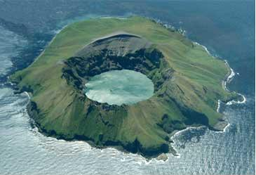
Kasatochi Island
Stratovolcano
314 m high (1030 ft)
~2.5 km in diameter (~1.5mi)
Water-filled caldera (800m d)
N
Extensive information about bird and marine mammal populations

Slide 6
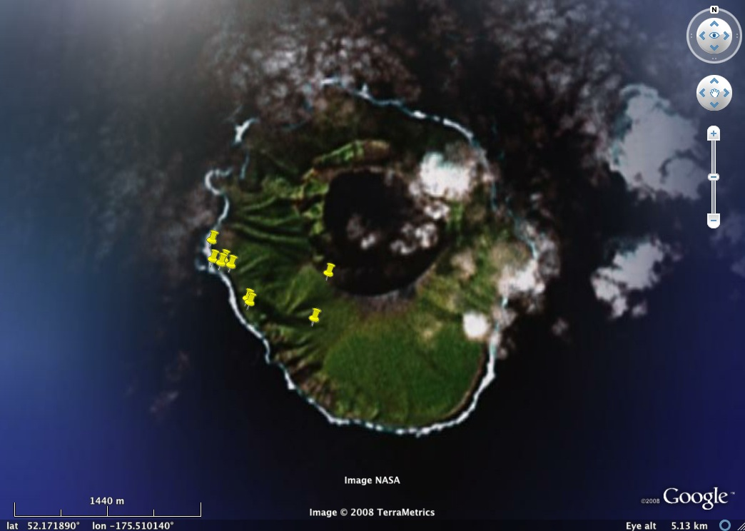
11 June 2008
10.66h
9 sites
0-290m el.
396 specimens

Slide 7
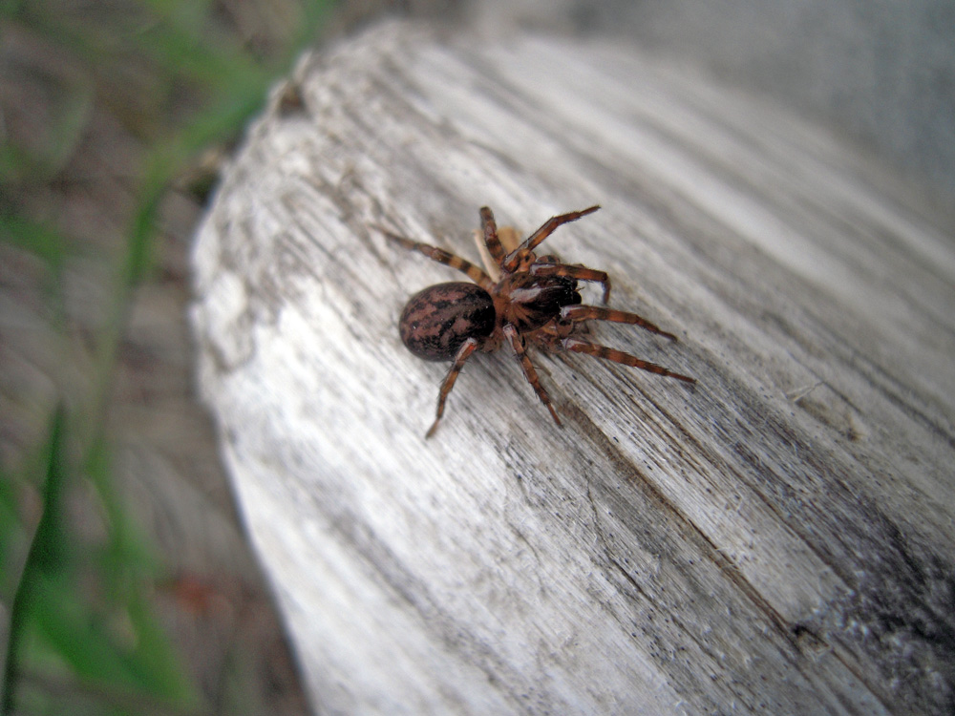
396 specimens, estimated 58 species
2 species new to science
2 species new to Alaskan fauna
total fauna probably >100 species

Slide 8
Eruption on 7 August 2008
Unanticipated and violent
M5.8 Earthquake (~ 500 M>2)
Relatively cool mud ash and water eruption
Hot (~800°C) pyroclastic flows
Ash cloud reached around 13 to 15 km

Slide 9
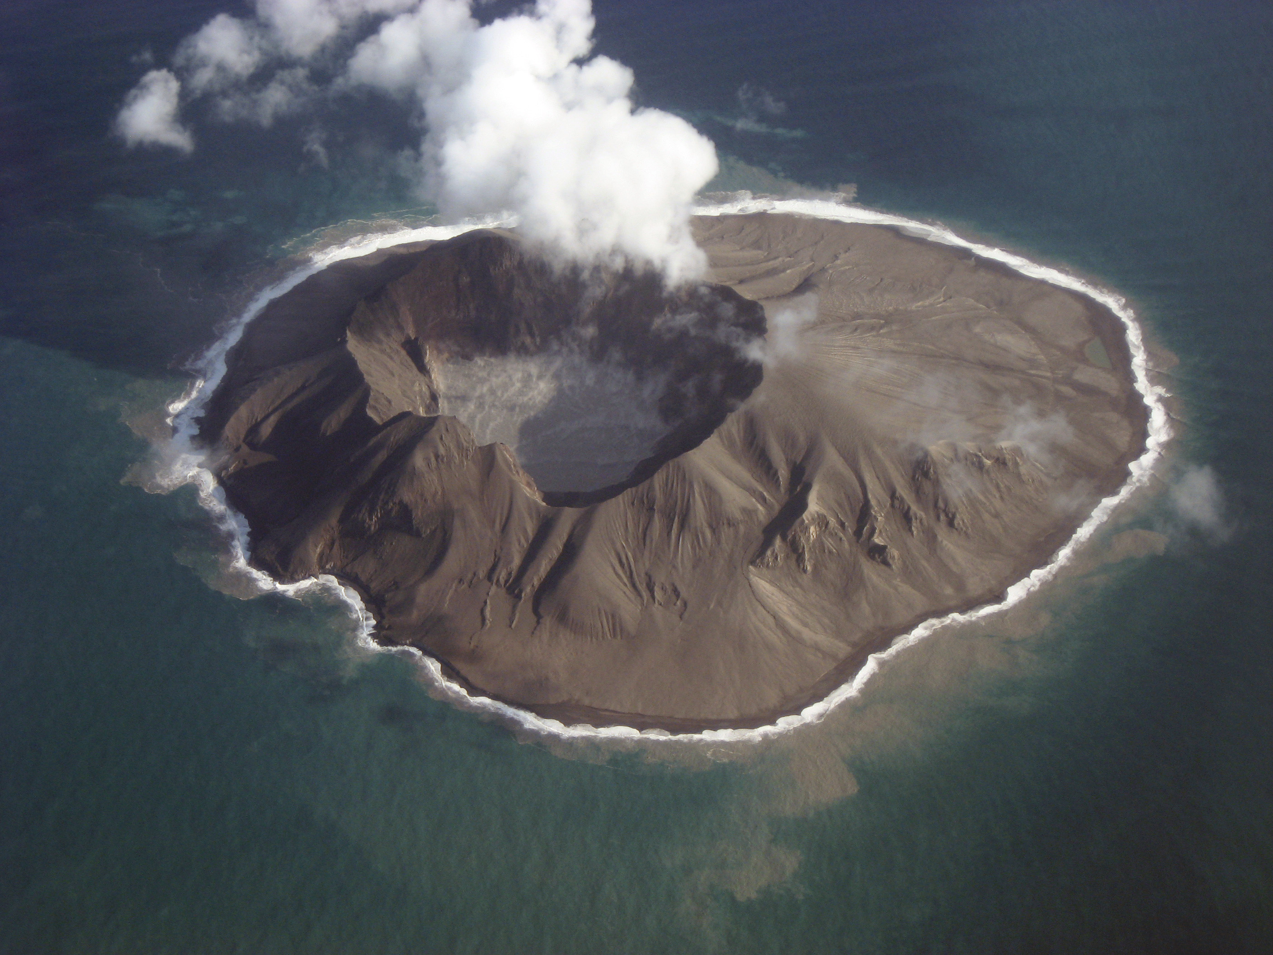
© 23 Oct 2008 by Jerry Morris

Slide 10
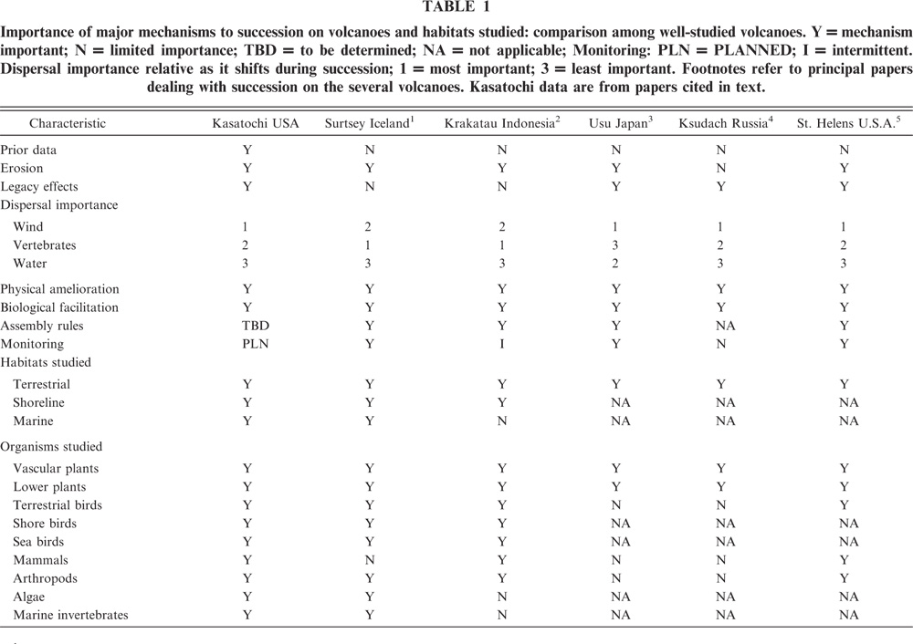

Slide 11
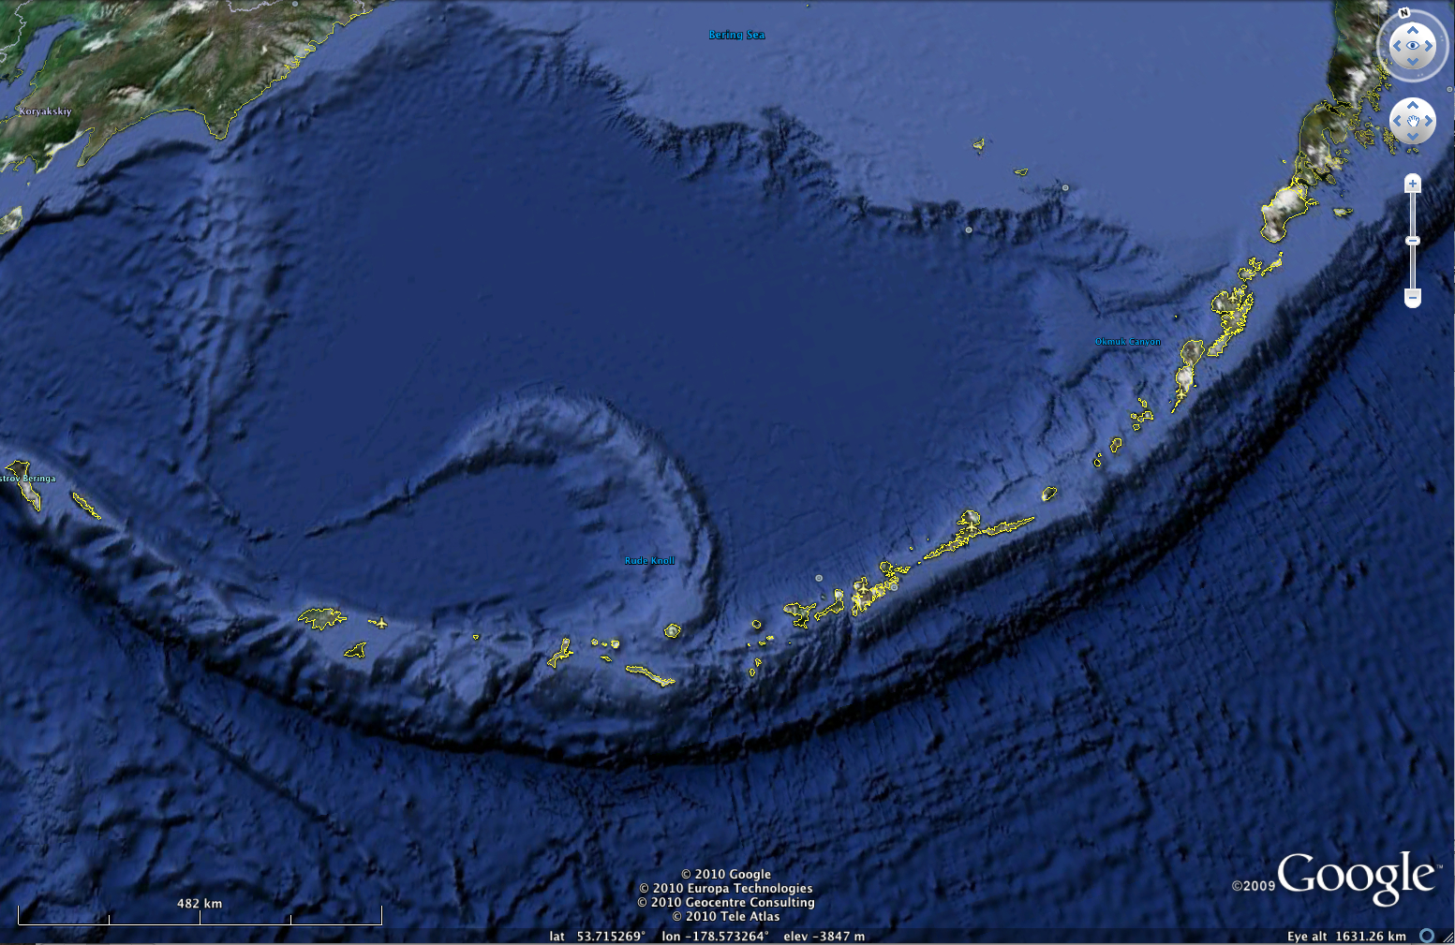
20-35 km from nearest islands (12-22 mi)

Slide 12
Expectations -
Year 1+ no survivors & no life
Colonizers from air, ocean drift, vertebrate transport
- few and rare with most failing to establish
Surtsey – 1964-1975, three arthropod species
(Thornton & New 2007)
© 23 Oct 2008 by Jerry Morris

Slide 13
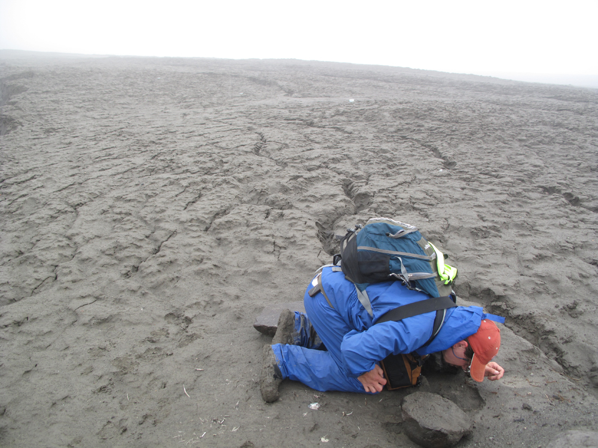
© Ned Rozell

Slide 14
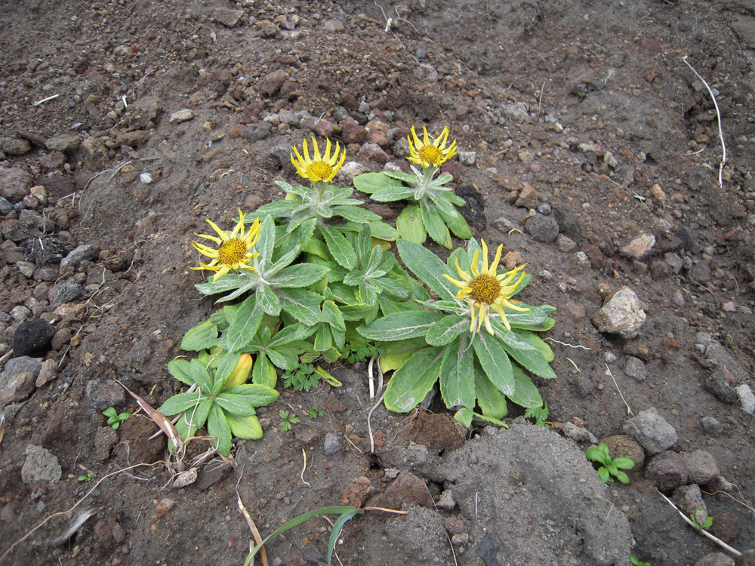
Senecio pseudoarnica

Slide 15
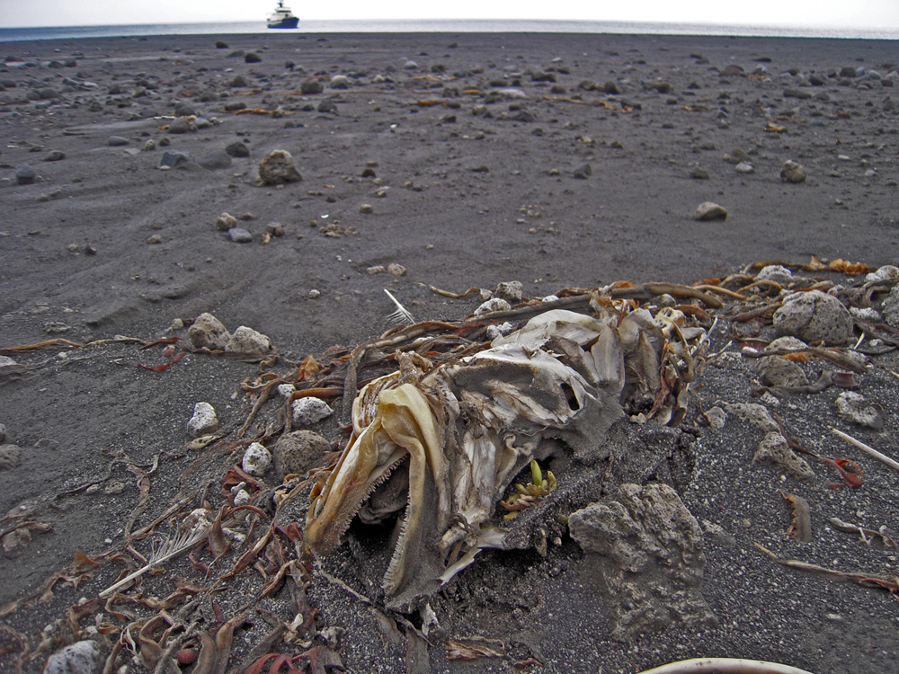

Slide 16
Findings, 2009
17 post-eruption species
presumed non-breeding survivors
4-9 breeding
Findings, 2010
7 lost from 2009
18 post-eruption species, most breeding

Slide 17
Findings, 2011???
Waiting on specimen processing and Identification.

Slide 18
Project Goals
Kasatochi Island
Methods
Results
Future work

Slide 19
Are the 2009 + 2010 populations descended from 2008 populations or are they descended from populations on other islands?
(survivors or immigrants)
How similar are the 2009 + 2010 populations genetically?

Slide 20
How to answer these questions?
Need:
Specimens
DNA
Successful COI gene amplifications

Slide 21
Gather specimens for DNA extraction

Slide 22
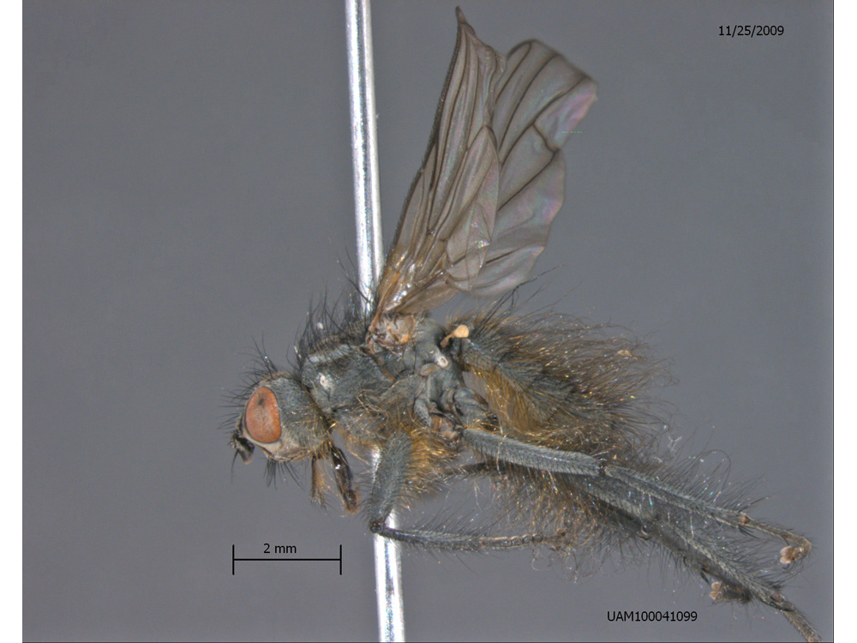
Scathophagidae:
Scathophaga frigida
Abundant near kelp post-eruption

Slide 23
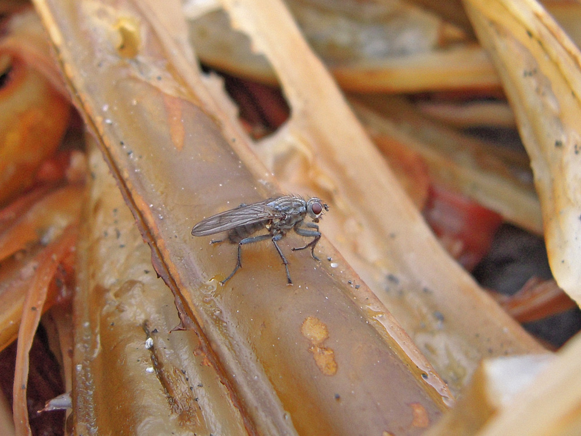

Slide 24
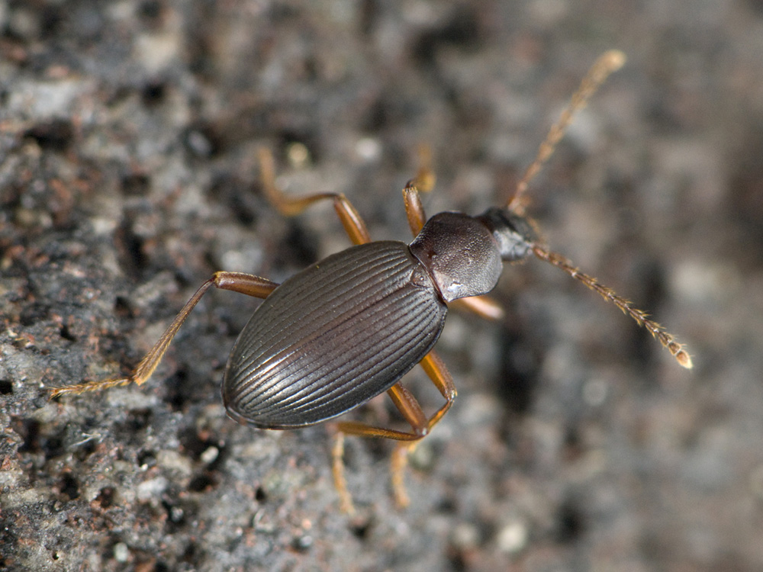
Agyrtidae: Lyrosoma opacum Mannerheim

Slide 25
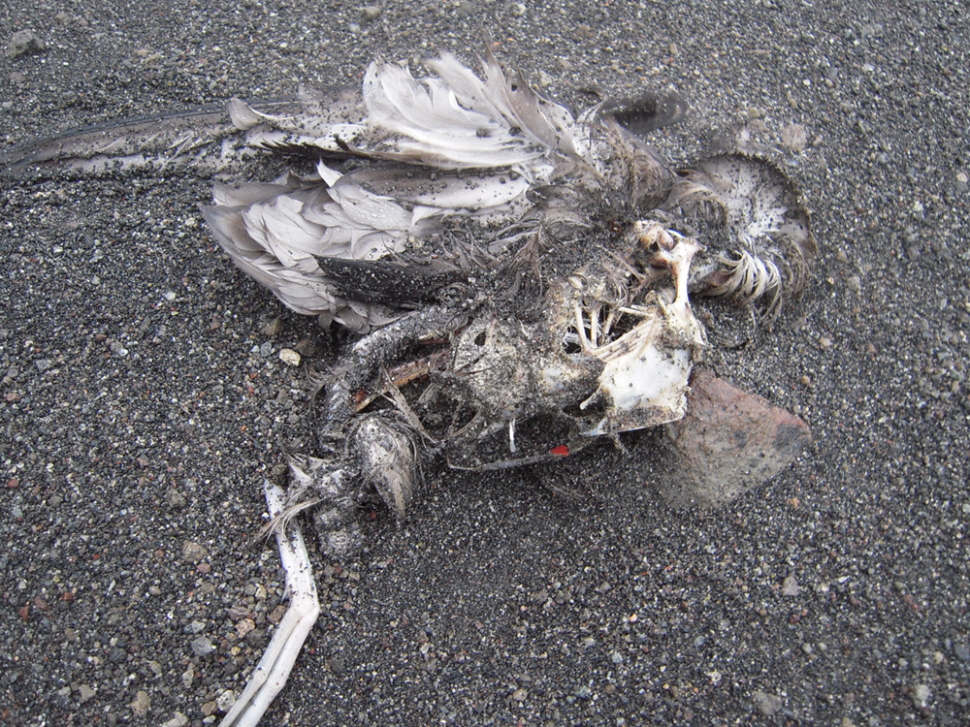

Slide 26
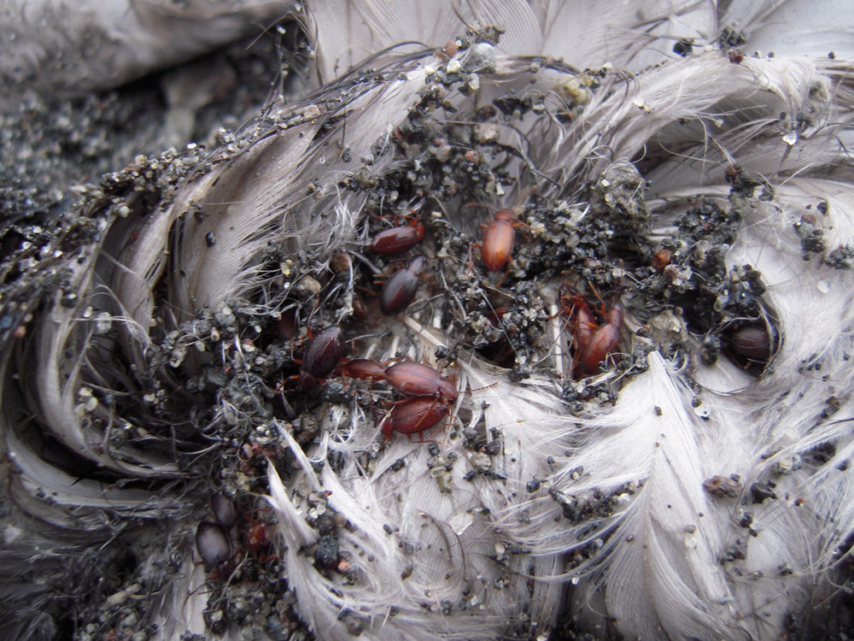

Slide 27
Once collected specimens needed to be prepared for DNA extraction
Processing field samples
Mounting relevant specimens
Cryovialing tissues
Identifying specimens

Slide 28
Obtaining DNA
QIAGEN DNeasy Kit
DNA from 2 sources: legs and whole bodies
Mass spectrometer to analyze success
Whole bodies = 335 ng/ul DNA
Legs = 35 ng/ul DNA

Slide 29
Amplifying the COI mtDNA gene
PCRs with standard forward (L-C-1490) and reverse (H-CO-2198) primers.
Gel electrophoresis to analyze success of PCRs
96 well plate containing successful amplifications sent to the HTGU at the UW for rapid bidirectional DNA sequencing
Sequences analyzed and compared

Slide 30
Problems encountered
Difficulties with Identification
Previously mounted un-cryovialed specimens resulting in unproductive DNA extractions
Unsuccessful COI gene amplifications
This work was completed for 2009 and 2010 Kasatochi Island specimens thanks to an undergraduate grant from Alaska EPSCoR in spring 2011

Slide 31
Project Goals
Kasatochi Island
Methods
Results
Future work

Slide 32
B
8.596% [A vs B]
A
4.803% [B vs C]
9.028% [A vs C]
C

Slide 33
MP bootstrap, 100 reps
Ave within clade uncorrected p
0.291%
8.596% [A vs B]
0.95
0.0388%
B
4.803% [B vs C]
A
9.028% [A vs C]
1.0
C
0.0655%
1.0
Above = MP Boot
Below = Bayesian PP
10,000,000 MCMCMC
GTR+I, saving 1/1,000
Burnin = 50% (5,000 trees)
Note: 2010 Scathophaga not
identified to species
Timeline
2009 2010
C A, B, C(rare) B(rare),C

Slide 34
So are the 2009 + 2010 populations descended from 2008 populations or are they from other islands?
uncertain– only one 2008 sample amplified
This 2008 samples is identical to most 2010 samples which suggests survivorship
need more samples!
How similar are the 2009 and 2010 populations genetically?
Not very- suggests large shift in insect community as species establish themselves

Slide 35
Project Goals
Kasatochi Island
Methods
Results
Future work

Slide 36
Future Goals
Process 2011 specimens from Kasatochi and nearby Islands
Amplify DNA of these specimens as well as the C0II Gene of Lyrosoma opacum specimens
Develop DNA techniques to amplify the other 2008 Kasatochi Island specimens
Compare and analyze Results
This work is currently being funded by an undergraduate grant from Alaska EPSCoR for the spring semester of 2012

Slide 37
Acknowledgements:
United States Fish and Wildlife Service
United States Geological Survey
National Science Foundation
Alaska EPSCoR
University of Alaska Museum
Dr. Derek Sikes
Steve Peek

